Slide 1
Project Kudu
The Magic behind Azure Websites
By Alexey Shcherbak
Kloud Solutions

Slide 2

What is Project Kudu?
Powers all Azure Websites features:
Full .SCM.AzureWebsites.Net console
WebJobs
Private Git Repo server
Build and deploy CI system
Open-sourced and developed @GitHub
Easily hosts inside your own IIS Server

Slide 3
How can I install it?
Clone the repo from https://github.com/projectkudu/kudu
Run build.cmd
Take artefacts from project folder:
KuduWeb – main app to create child apps\sites
SiteExtensions – Admin app for each site
Configure your IIS and few web.config paths\settings
…
Profit!

Slide 4
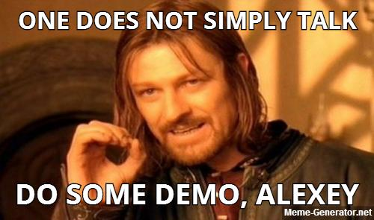

Slide 5
Main kudu features.
Deploy with git push.
WebHooks with sms (Zapier/Twilio)

Slide 6


Slide 7
Full IIS vs IIS Express
Like IIS but without maintenance hassle.
Dev environment is closer to test\production one – less “configurations-dependant” bugs.
Your machine server is publicly available to other devs and showcases of Work-In-Progress stuff.

Slide 8
Your own Micro-CI
Quick HTML | CSS | JS updates after “git push”. Like front-end “edit-save-refresh” approach.
Can run your tests in background (in theory).
Can notify you via PostDeployment hook - less time for coffee and socializing, yaw!
Kudu can do custom build scripts too…

Slide 9
Web Jobs
Easy way to do background service via “continuous job”
Build your own scheduler ☺
Stored in repository, no need to install
Quick and easy way to set up triggered processing.
E.g. “run this powershell script when JobX url called”

Slide 10
Custom version of Kudu in Azure
Customize Kudu build and push it into your Azure Websites deployment
Flexibility and level of control, like what Software-as-a-Service provider has
Easy to fix bugs and add bleeding edge features

Slide 11

Dark sides ?
YES, we do have few of them…

Slide 12
Bad sides and murky waters
No authentication out-of-the-box – not ready for prod.
Is it secure? Main app runs under LocalSystem account.
On-prem is not on a par with Azure functionality
Lack of obvious things – SSL certs, web.config settings
No public API, yet.
You can still call MVC actions – they are pretty API-ish.
Action Routes are evolving rapidly, and it’s a mess ☺.

Slide 13
Bad sides and murky waters continued…
You can ruin your Azure websites deployment badly.
Reaping what you sow.
Bleeding edge stuff breaks, often. Really OFTEN.
If it’s working for you – don’t update ☺
Build routine is not very intuitive.

Slide 14

Any questions?

